Slide 1
Book-it
Stephanie Chua for OCBC Cinemas

Slide 2
Book-it
BOOK-IT is a mobile app that enables consumers to book movie tickets on the go. It is designed exclusively for OCBC cinemas.

Slide 3
Customer journey: before booking
Collecting Real Tickets allow to look back at the time spent with friends and mobile tickets are ugly, decides to book in person.
Finding out about movie
Through social media and word of mouth.
User reviews: Limited compared to Rotten Tomatoes,
exits to Rotten Tomatoes
1
3
5
2
4
Theatre apps: only summary seen, no trailer; Switches to YouTube.
Shares YouTube video: Gets friends/ family to join them to watch the movie

Slide 4
Customer journey: Booking process
Unclear : Some seats are reserved for couples and not for single booking.
Frustration in figuring that out leads user to book on website instead when she reaches home
Unable to decide : Not sure what friends would like to eat on that day
Flooded with deals on Google and social media
1
3
5
Back and forth between show timings/ venues as pricing is only shown upon selection of seat
2
4
6
Time-limit : Unable to go through snack promotions properly due to time limit on seat reservation
Troublesome : Typing in credit card numbers.

Slide 5
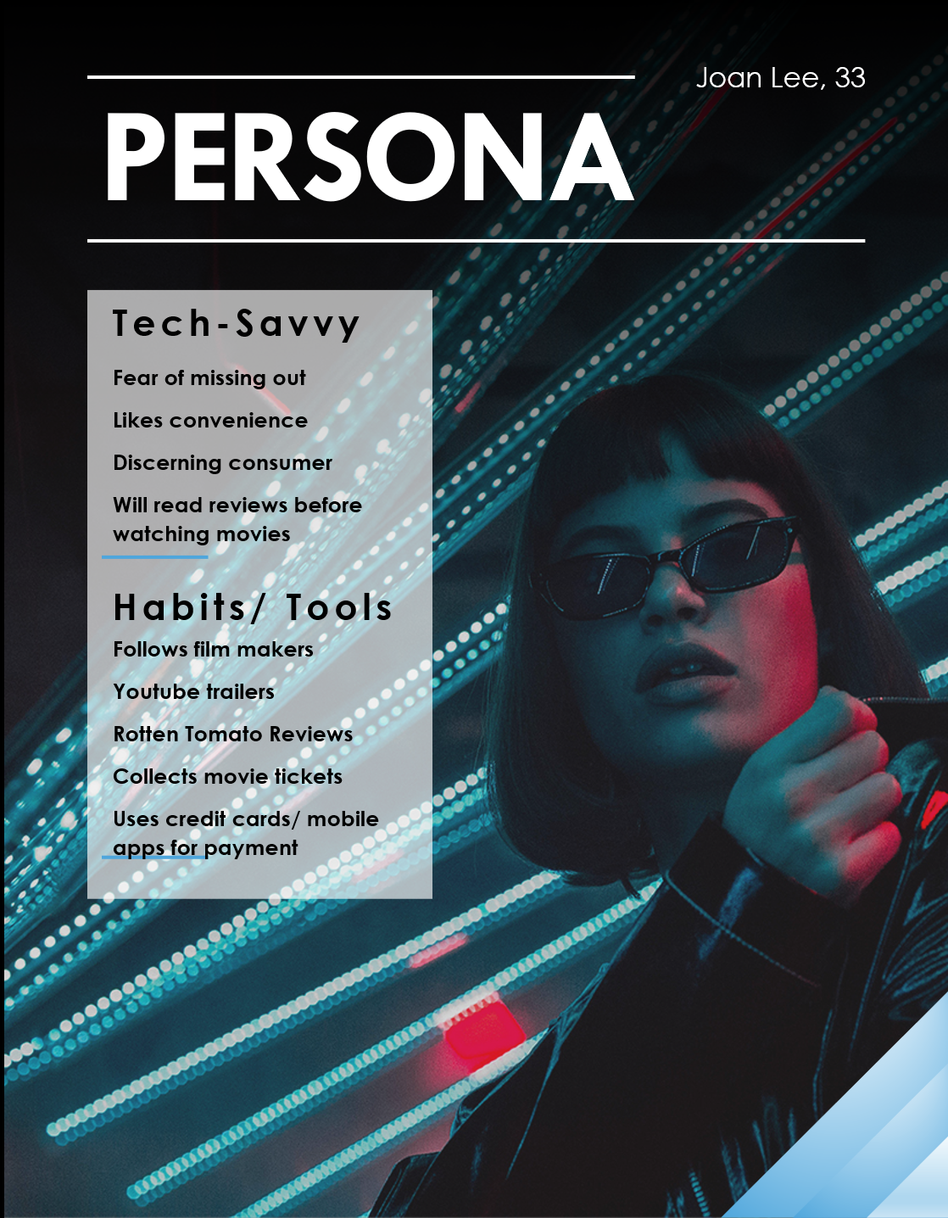
UNIQUE
Joan is outgoing and sociable and likes to be in the scene. She recently went to the Ice Cream Museum. She took many pictures with her friends and uploaded it to Instagram. She values Instagram as each post represents the most beautiful snapshot of a memory that she would remember for years to come.
Payments
Social Channels
Credit Cards
Apple Pay
Instagram
Facebook
Sources of Information
Social Media
Friends
YouTube
Rotten Tomatoes
IMDB
Google

Slide 6
MARKET OVERVIEW
19 million tickets
15.3%
64.73%
Sold per year before COVID.
This is a relatively small drop in ticket sales compared to Singapore’s historical high of 22 million in 2011.
Current estimates by PwC put the compound annual growth rate of revenue from on demand video here to be at 15.3 per cent between 2019 and 2024.
Of the gadgets in Singapore are mobile devices. Having a good app installed on user’s devices is important in ensuring availability of delivering ticket sales.

Slide 7
PROBLEM
Continued strength
There has been a relatively slight decrease in movie tickets sold over the decade. There is still great interest in the experience of going to a movie.
Weakness: app design and user engagement
Interviews have revealed that mobile apps in Singapore for this market are difficult to use, usually ugly, and do not have the content that users want. They end up turning to YouTube, IMDB, or on the web booking.
Threat: on demand streaming
On demand streaming market has been bolstered and in fact, expedited by the COVID situation. That is seen in forecast numbers and in our interviews.
Opportunity
How do we boost the strength of a movie theatre experience while potentially capitalizing on the advent of on demand streaming?

Slide 8
demo

Slide 9
Value proposition
CLOSE THE GAP
TARGET AUDIENCE
Our product makes consumer lives easier, by making the movie ticket booking journey seamless and providing digital tickets that can be kept and shared for memories.
Our target audience are the Digital Natives and Residents who thrive on social media and appreciate experiences that can be recorded on their digital footprint.
CAPITALISE ON INCOMING THREATS
EASY TO USE
Using hyper-personalization to refer consumers to new movies as well as take a cut when we refer consumers to on-demand streaming services.
Simple design that gives customers the targeted information they need.

Slide 10
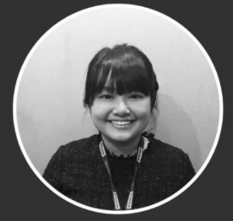
THANK YOU
Stephanie Chua
+65 9741 7109
csq.stephanie@gmail.com
Github: @cotldus
LinkedIn: in/chuastephanie

